Slide 1


Selection Operation in DBMS
by Sandra Shine

Slide 2
Content
Query processing
Selection query
Selection types
Implementation
Evaluation and Optimization
Conclusion

Slide 3
Introduction to Query Processing
Query Processing
Efficient Execution
Interpreting, searching, and retrieving data from a database.
Converts queries into efficient execution plans for faster results.

Slide 4
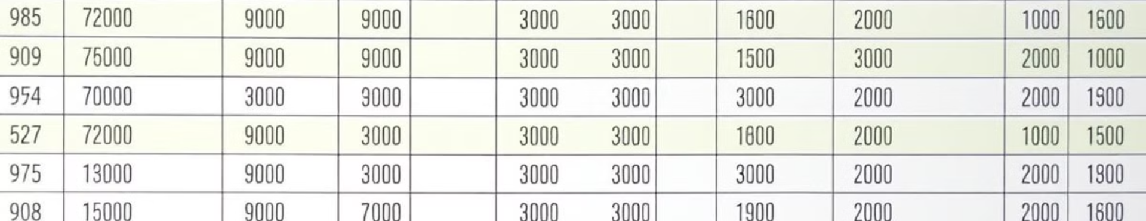
Selection Operation
1
Fetching Rows
2
Relational Algebra
3
Handling Data
Selects specific rows that meet defined conditions.
Represented by σ (sigma) in relational algebra.
Essential for efficiently managing large datasets.

Slide 5
Benefits
Improves query efficiency .
Essential for retrieving specific data from large datasets.
Reduce data size for processing .

Slide 6

Types of Selection
Simple Selection
Complex Selection
Single Condition.
Multiple Conditions. Uses AND, OR, NOT.
σ_Age>25(Student)
Conjunction (AND, ∧) :σ_Age>25 ∧ Gender='M'(Student)
Disjunction (OR, ∨):σ_Age>25 ∨ Gender='F'(Student)
Negation (NOT, ¬) :σ_¬(Age<18)(Student)

Slide 7





Implementation Methods
Linear Search
Scans each record sequentially.
Binary Search
Divides search space on sorted data.
Index-Based
Uses indexes (B+ Trees, Hashing).
Bitmaps/Filters
Speeds selection in large datasets.

Slide 8

Evaluation & Optimization
Evaluation
Performance Optimization
Checks each rows against conditions. Pick the rows that satisfies the given condition.
Using Indexes - help to locate data quickly (B+ Trees, Hashing).
Partitioning & Clustering for Faster Lookups - Organizes data into smaller sections.
Query Optimization Techniques to Improve Performance - Restructures queries for speed.

Slide 9
Result set
it includes rows matching the query conditions.
It can be processed, sorted, or combined with other data sources.
SQL Selection Queries
Simple Query
1
SELECT * FROM Employee WHERE Salary > 50000;
Complex (AND)
2
SELECT * FROM Student WHERE Age > 18 AND Gender = 'F';

Slide 10
SQL Selection Queries
SELECT * FROM Employee WHERE Department = 'IT' OR Salary > 60000;
Select employees who are in the IT department or earn more than 60,000.
SELECT * FROM Customers WHERE NOT City = 'New York’;
Select customers who are not from 'New York’.
SELECT * FROM Student WHERE Name LIKE 'A%’;
Select students whose names start with 'A’.
SELECT * FROM Employee WHERE Salary BETWEEN 40000 AND 80000;
Select employees with salaries between 40,000 and 80,000.
SELECT * FROM Customers WHERE City IN ('New York', 'Los Angeles', 'Chicago’);
Select customers from 'New York', 'Los Angeles', or 'Chicago'.

Slide 11

Conclusion
Fundamental
Optimized
Selection is fundamental in DBMS.
Optimized selection methods improve performance.
Techniques
Indexes & optimization techniques are essential.

Slide 12

THANK YOU
I appreciate your time and attention. This concludes my presentation on selection operation in DBMS.

